Slide 1

OOPS - Encapsulation
By : Panjala Nithin Kumar

Slide 2
WHAT IS ENCAPSULATION ?
In general, is the action of enclosing or binding something.
In OOP, it is a way of combining both data and functions that operate on that data, into a single unit.
In other words, we can say that the Encapsulation is the wrapping up of data and functions (methods that operate on the data) into a single unit (called class).

Slide 3
WHY ENCAPSULATION ?
Encapsulation – A way to implement Abstraction
Data Hiding
Getter and Setter Methods
Code Reusability
Flexibility and Maintainability

Slide 4
Encapsulation in the Real-World
For example, we would like to access YouTube on our system to see some tutorials on OOPs concept .
But , we do not have access to it . It was restricted to us by the networking team.
If we put a request to the team, they will provide us with the access to the tutorials .
Consider that the tutorials are state/variables/data
Networking team as the methods/functions.

Slide 5
IMPLEMENTATION
In order to achieve encapsulation in Java, we have to −
declare the variables of a class as private, so that they cannot be accessed directly from outside the class.
provide setter and getter methods that are declared as public, to view and change the values of the variables.
variables
private
methods
public

Slide 6
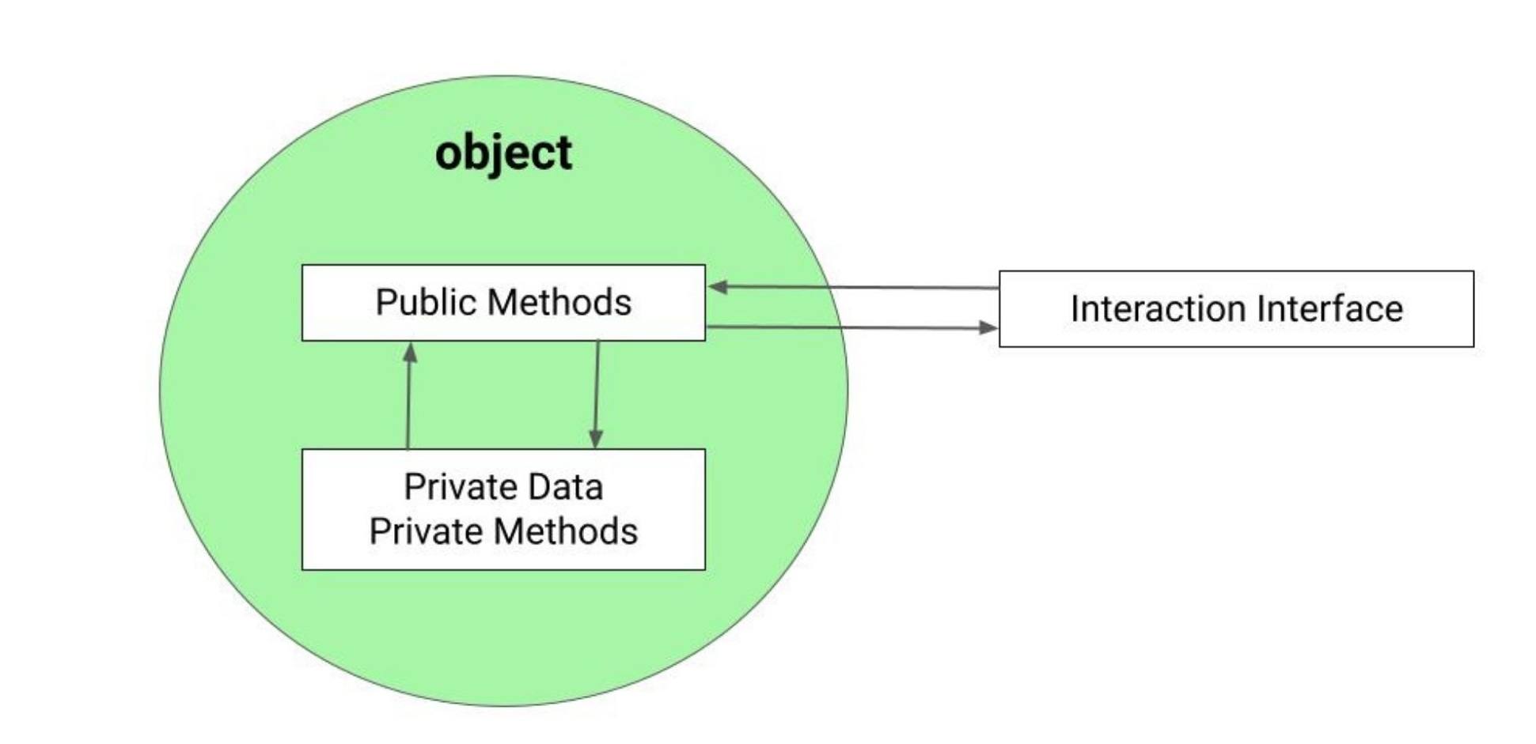

Slide 7
Sample Code :
class Employee { private String name; private int age; private int salary; private String Designation; public Employee(String s){ name = s; } public void setAge(int a){ age =a; } public void setSalary(int s){ salary = s; } public void setDesignation(String s){ Designation = s; } public void getEmpDetails(){ System.out.println(name+" "+Designation+ " " +age+" "+salary); } }

Slide 8
public class TrailClass { public static void main(String args[]){ Employee nithin = new Employee("nithin"); Employee naveen = new Employee("Naveen"); nithin.setAge(25); naveen.setAge(29); nithin.setSalary(30000); naveen.setSalary(40000); nithin.setDesignation("Software Engineer Trainee"); naveen.setDesignation("Senior Software Engineer"); nithin.getEmpDetails(); naveen.getEmpDetails(); } }
OUTPUT :
nithin Software Engineer Trainee 25 30000
Naveen Senior Software Engineer 29 40000

Slide 9
THANK YOU !!

